Slide 1
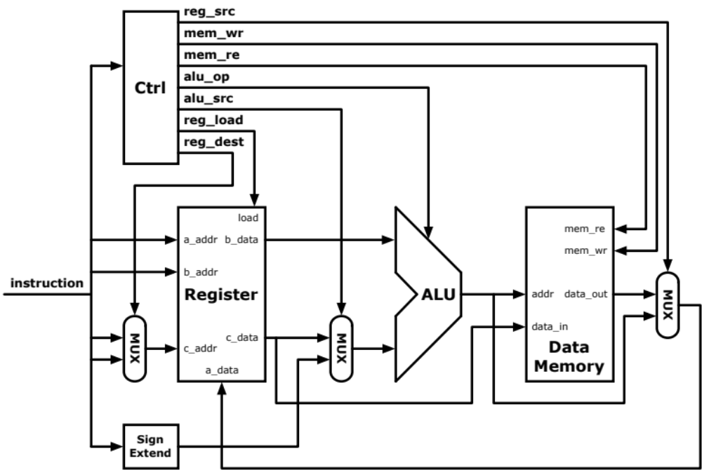

Slide 2
Instruction
Logic

Slide 3
Instruction
Logic

Slide 4
TestBench
Instruction
Logic

Slide 5
Instruction
Memory
Instruction
Logic

Slide 6
Instruction
Memory
Instruction
Logic

Slide 7
Instruction
Memory
Instruction
Logic
PC

Slide 8
PC_out + 2
Instruction
Memory
Instruction
Logic
PC

Slide 9
PC_out + 2
Instruction
Memory
instruction.txt
Instruction
Logic
PC

Slide 10
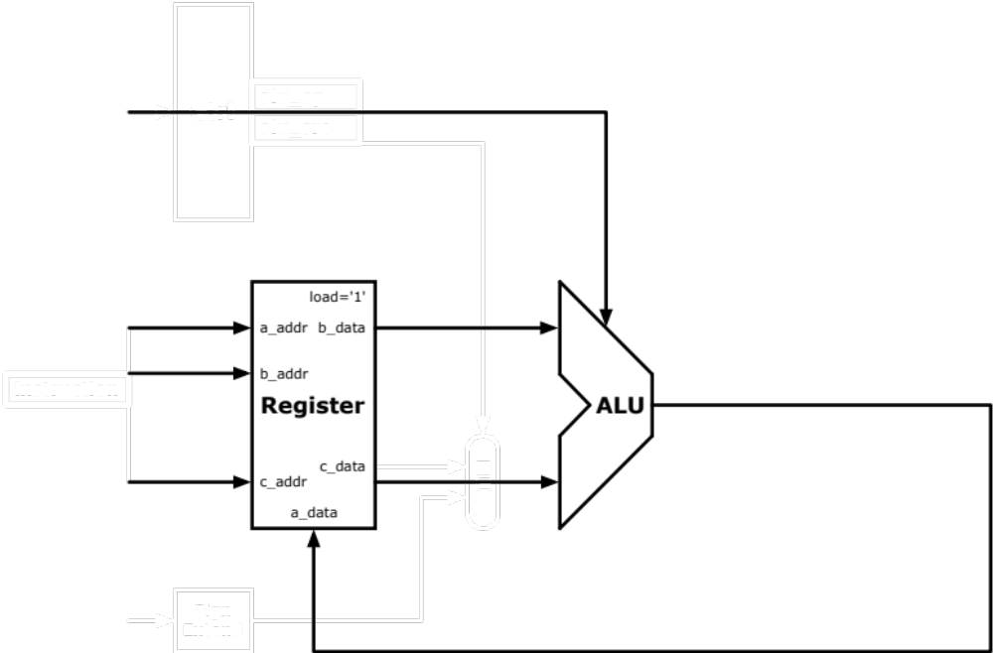

Slide 11
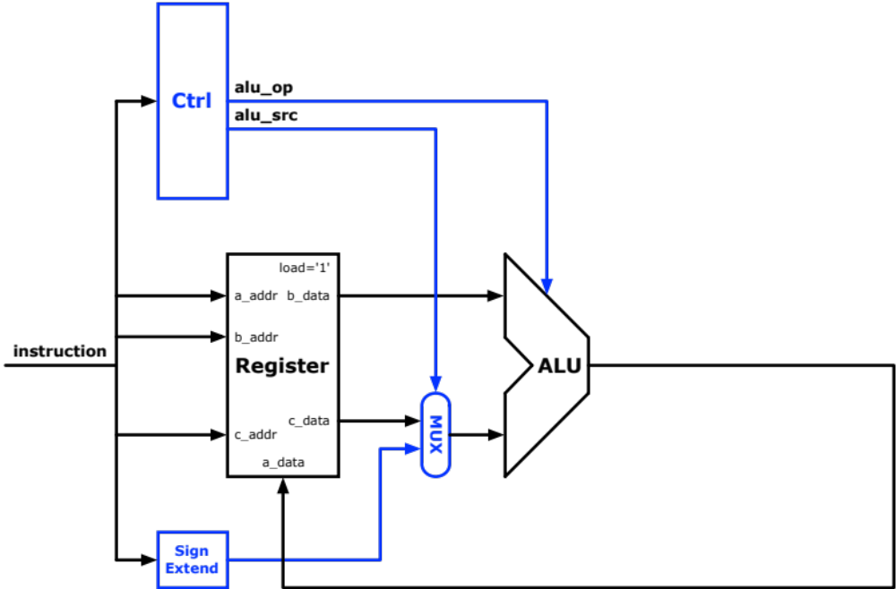

Slide 13
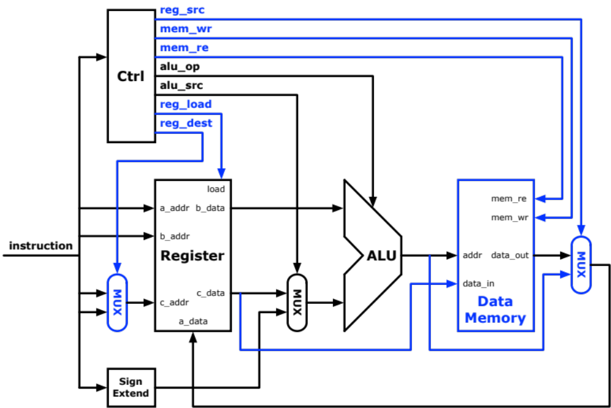

Slide 14
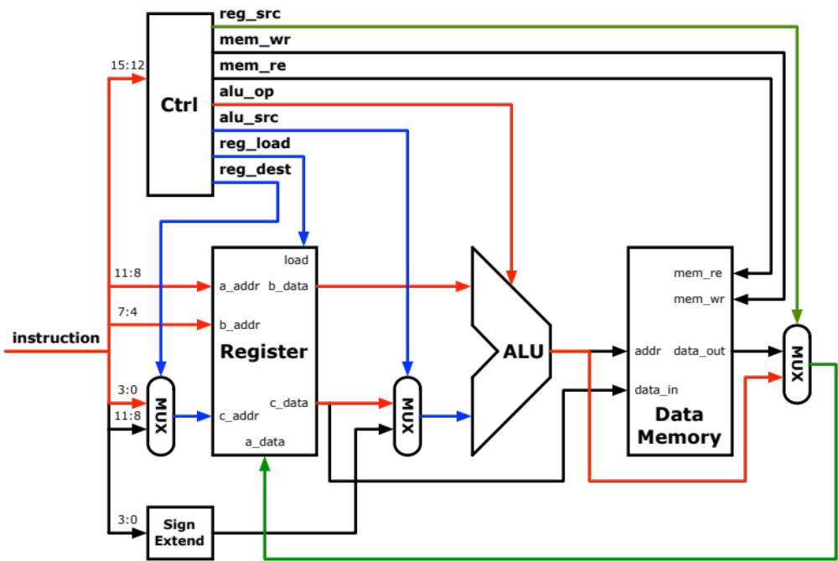
R-Type

Slide 15
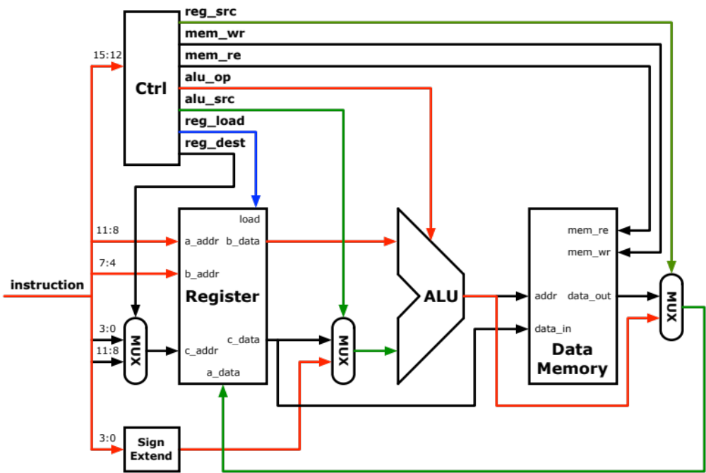
I-Type

Slide 16
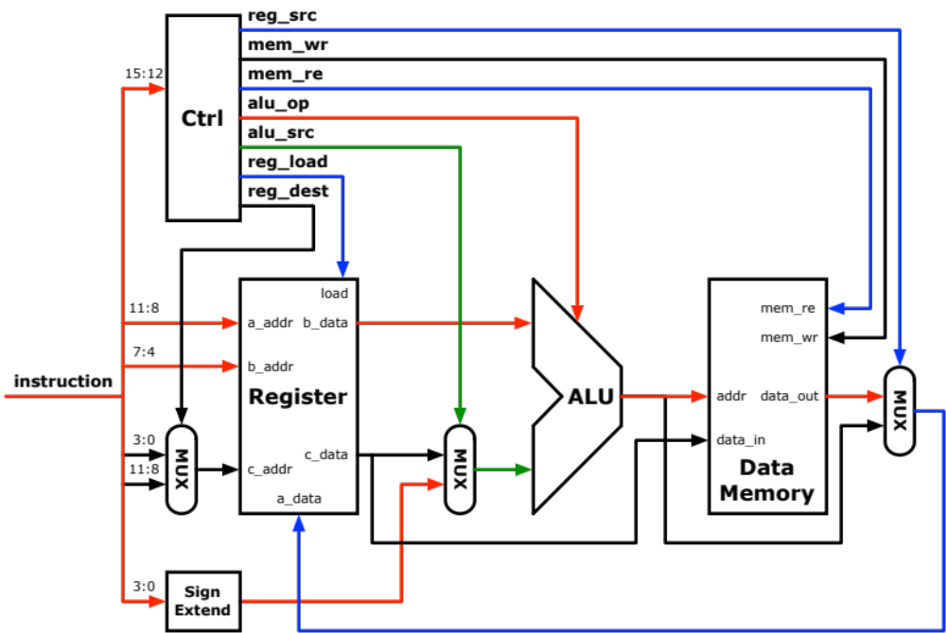
LW rd, Imm(rs)

Slide 17
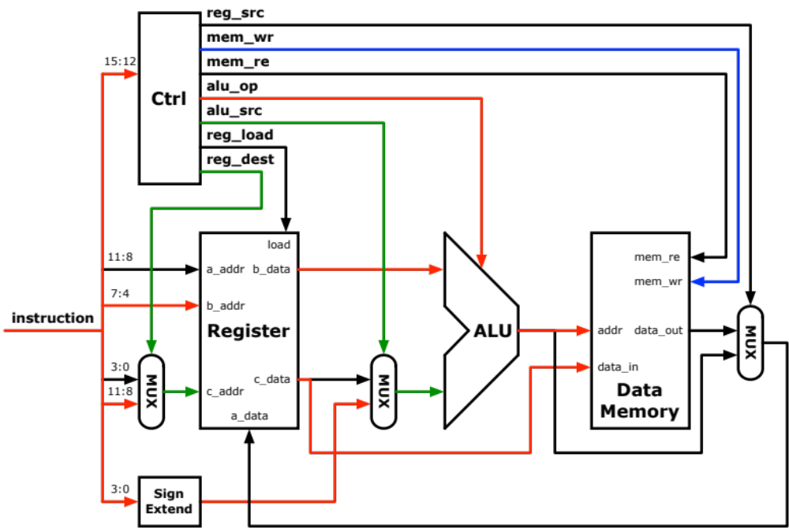
SW rd, Imm(rs)

Slide 18
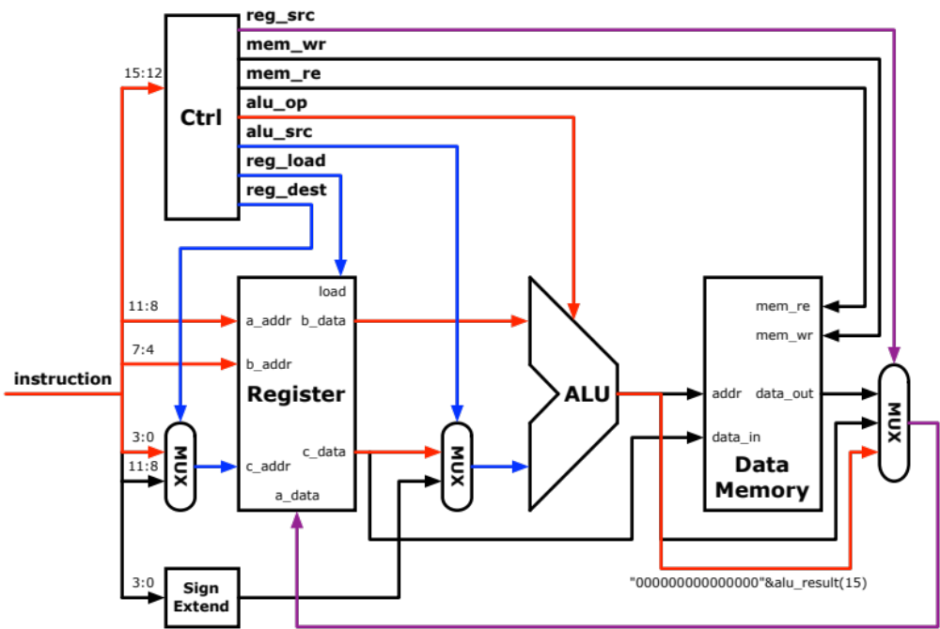
slt r2, r0, r1

Slide 19
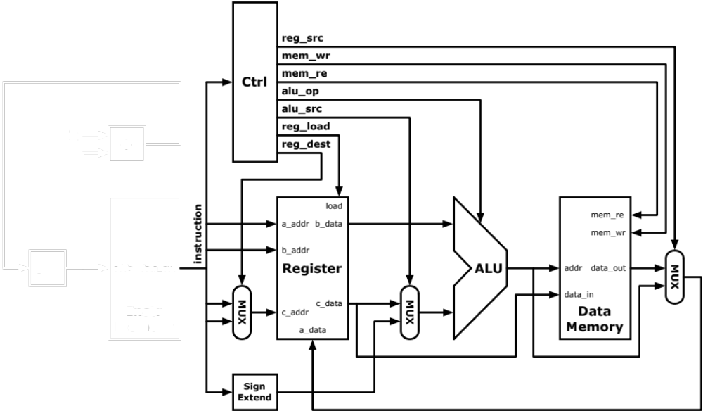
PC

Slide 20
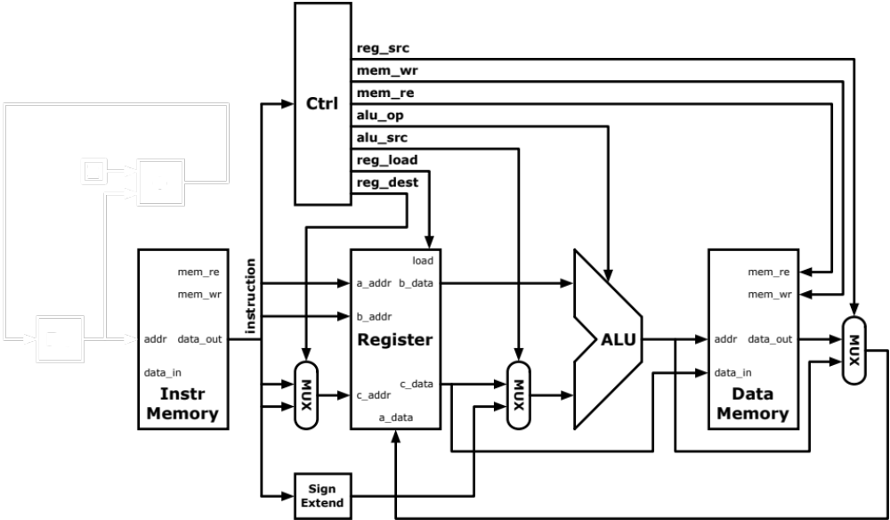
PC

Slide 21

PC

Slide 22
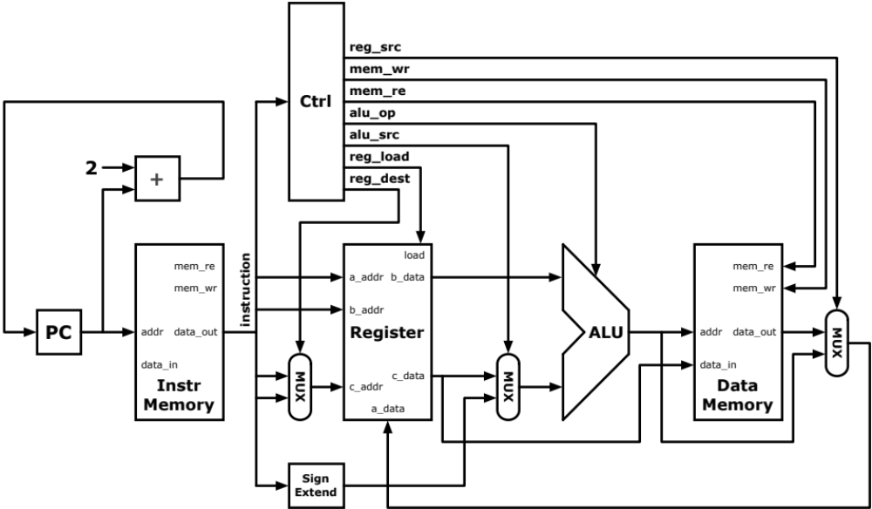
PC

